Slide 1

Good vs. Evil
By: Megan Adams, Lyndah Mupfunya, Brandilyn Hall, Matthew Witschorke

Slide 2
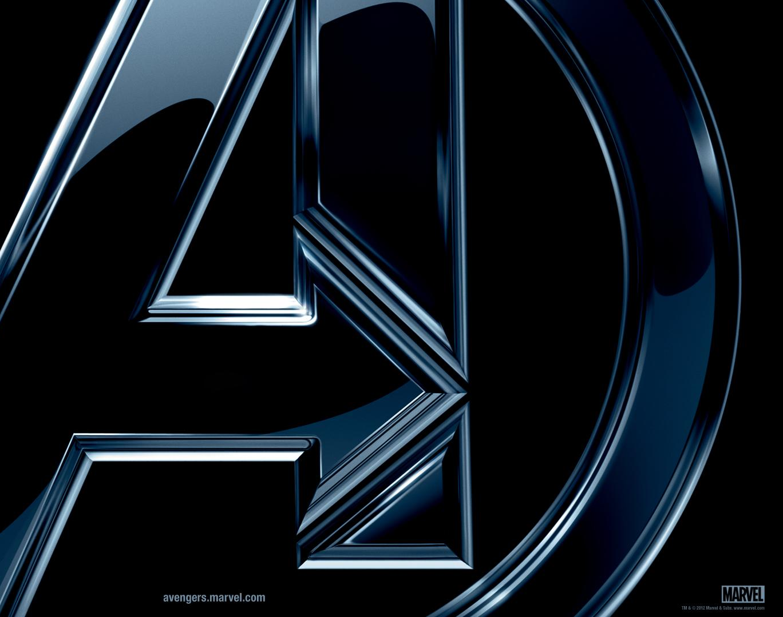

Inspiration
Our inspiration comes from the Marvel movies and the struggle between good and evil. We found interesting Kaggle datasets that allowed us to explore the Marvel Universe and learn more about the heroes and villains that live there. We also viewed Tableau visualizations that gave us ideas of how we wanted to go about creating our own.
Kaggle – Marvel Superheroes
Tableau – Marvel Visualizations

Slide 3
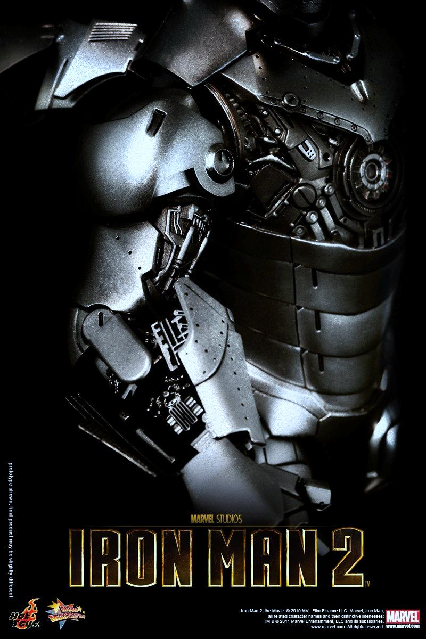

Data Source
Marvel Superheroes (Kaggle)
Contains 8 csv files covering
Stats
Characteristics
Powers matrix
Comics appeared etc.
We merged the character info with the power matrix

Slide 4
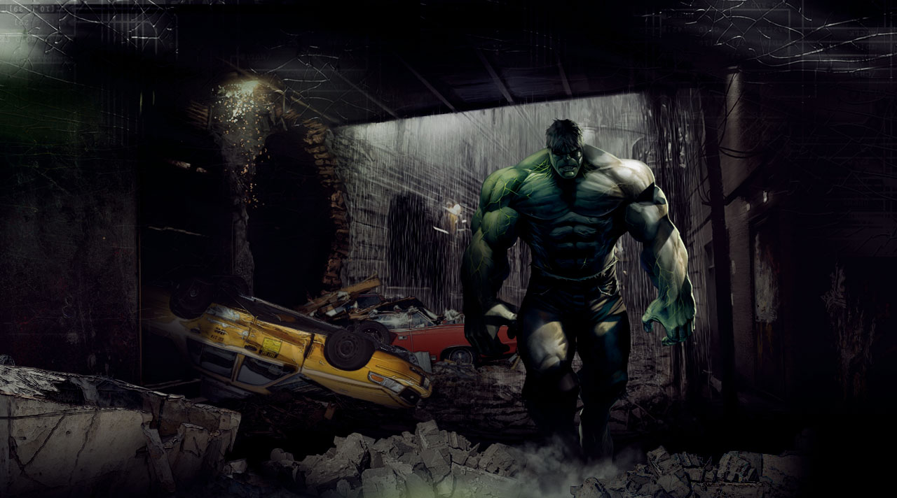

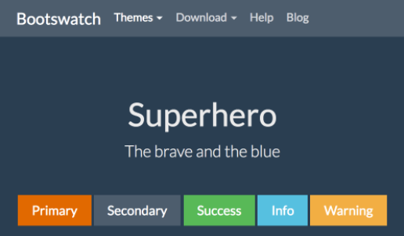
Design
Colors:
Theme:
Feel:
Comic book and fun atmosphere - transporting you to the Marvel Universe

Slide 5
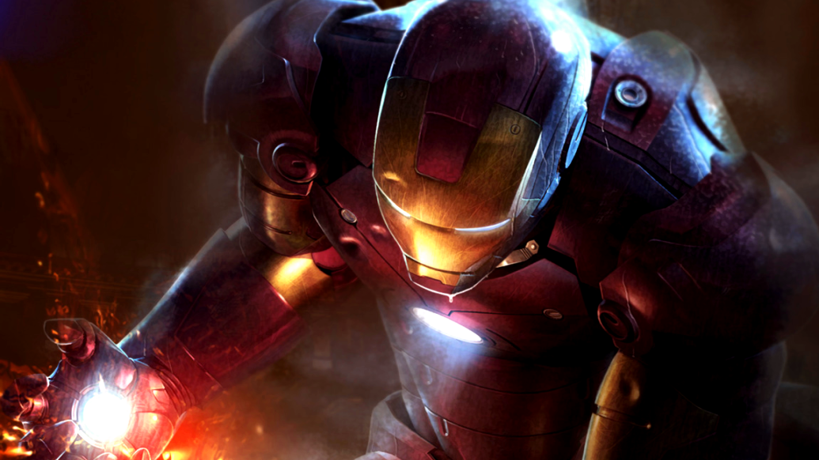
Questions
Does good triumph over evil when comparing their statistics?
Which character is the most powerful?
What are the similarities/differences of the most powerful characters?

Slide 6
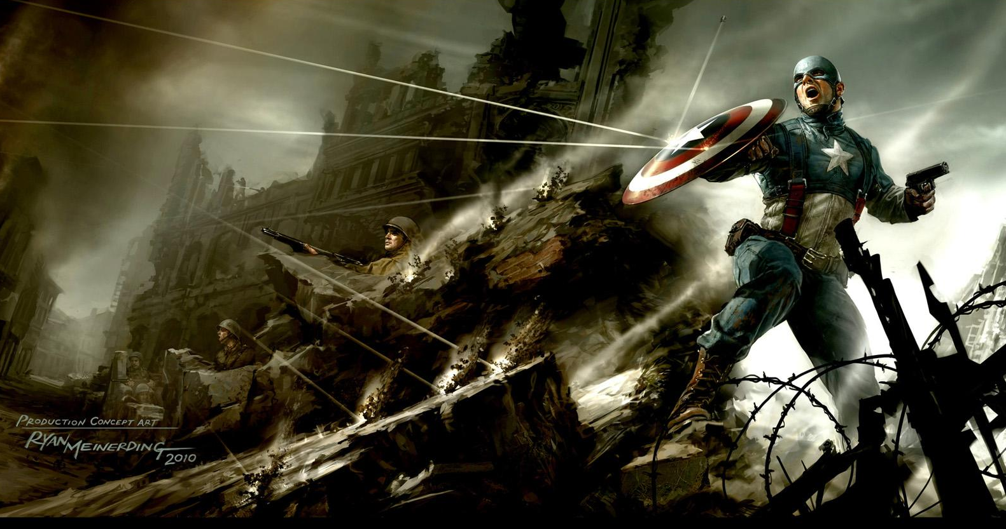
Dashboard Preview

Slide 7


Conclusions
Stardust is the most powerful Marvel character based on combined power score
On average, the Neutral category is the most powerful, followed by bad
The most powerful characters are male and 2 of the 3 of the Kryptonian race

Slide 8
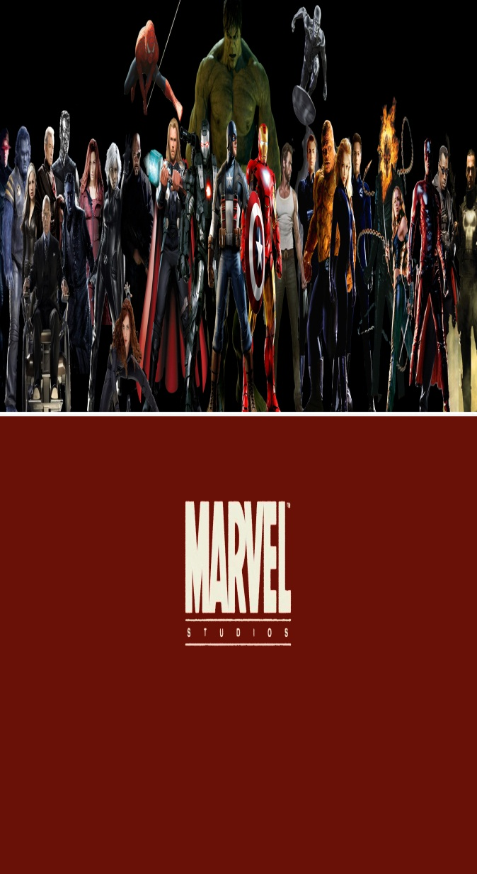
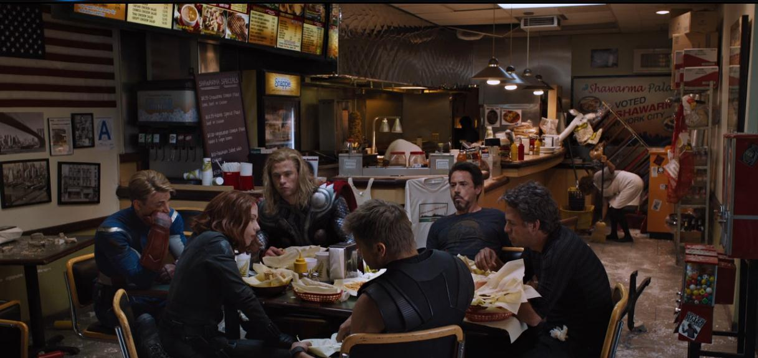
Limitations and Future Work
Limitations:
Did not have location information (no map)
Most are fictional places anyway
API didn’t have what we were looking for
Future Work:
Make all radar charts dynamic
Include a multi-select dropdown to compare multiple heroes from one dropdown

Slide 9
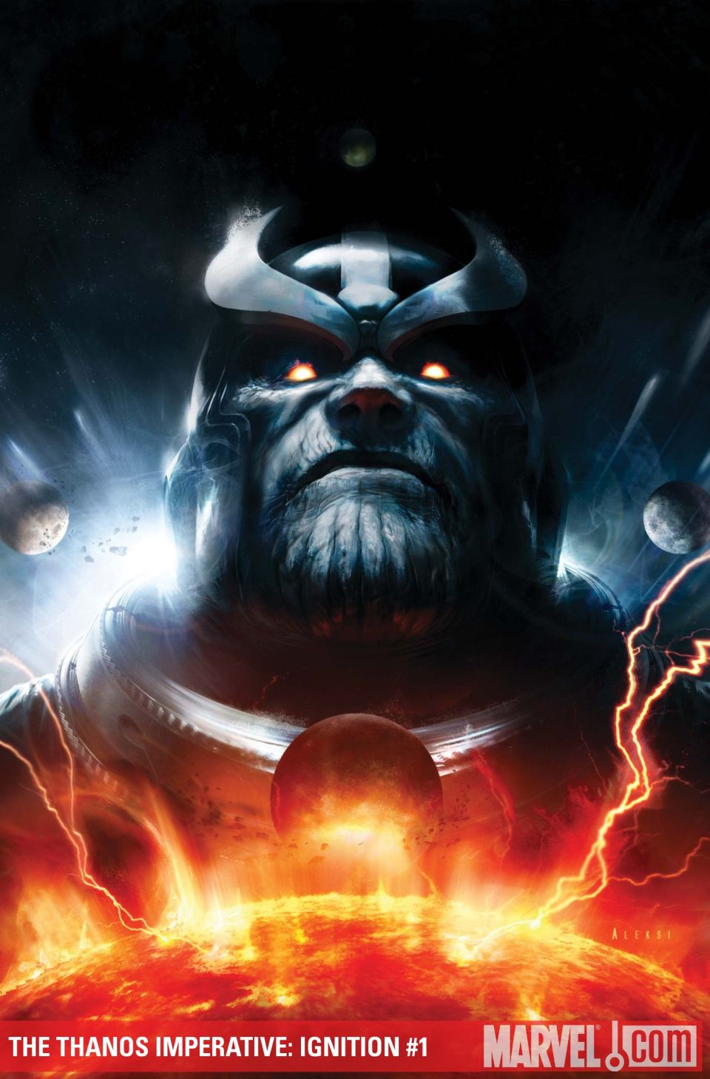
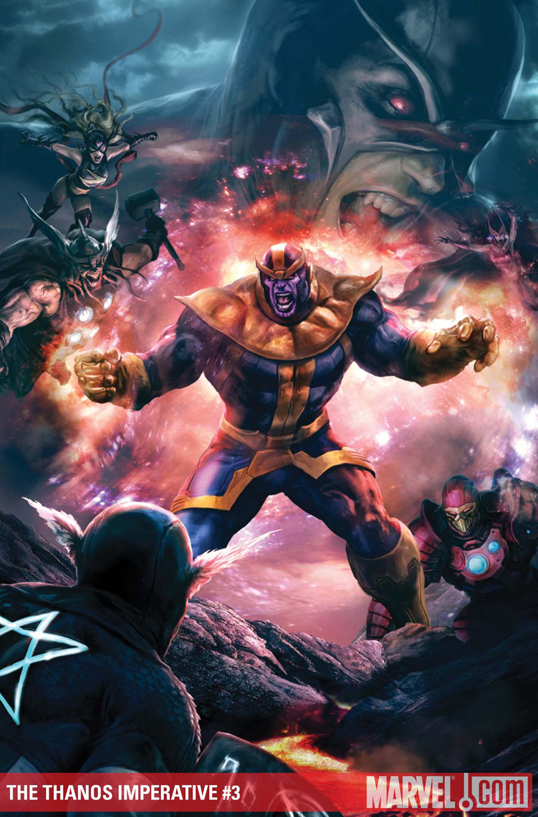
Questions?

Slide 10

The End

Slide 11
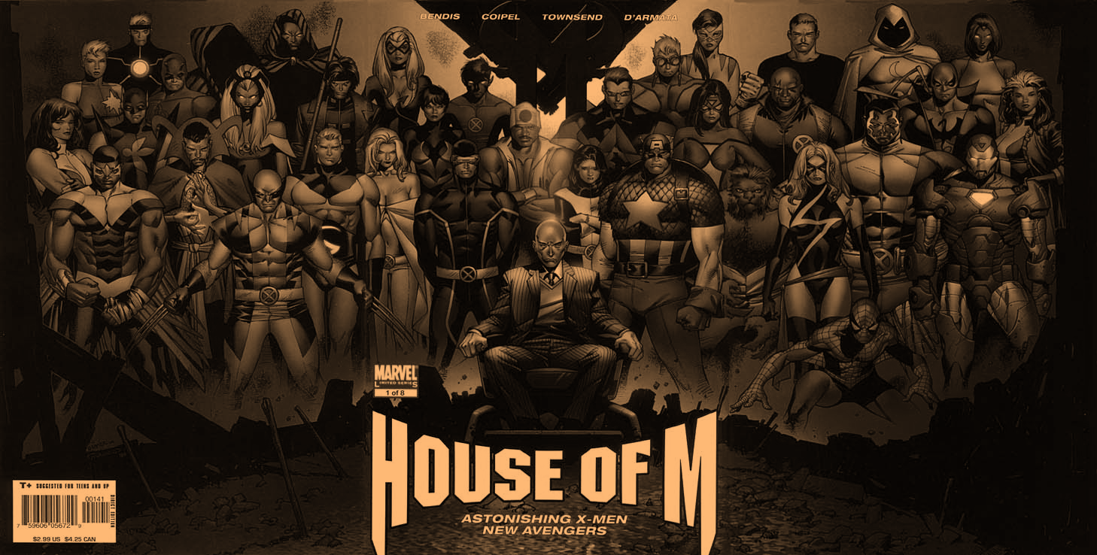
1
M皇室一族
HOUSE OF M

Slide 12
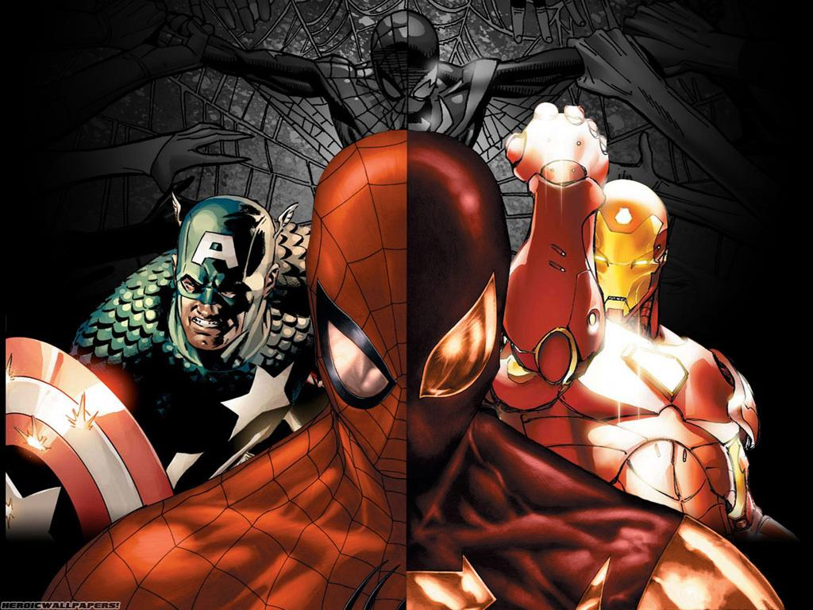
2
内战
CIVIL WAR

Slide 13
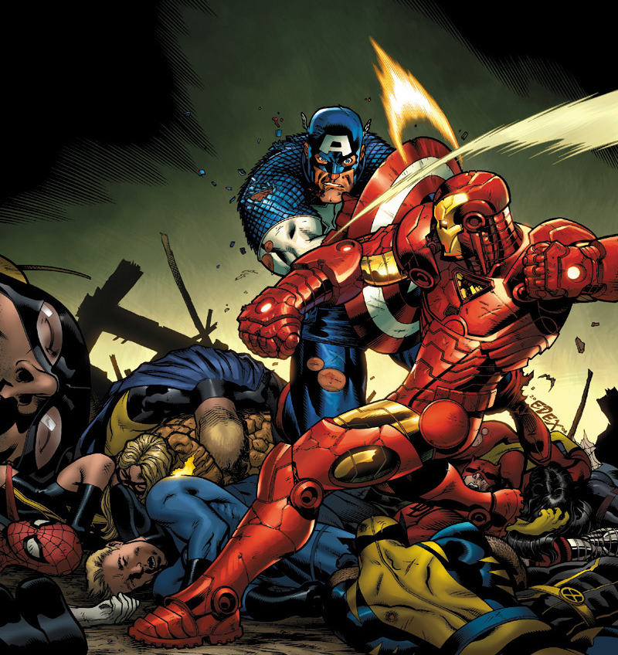
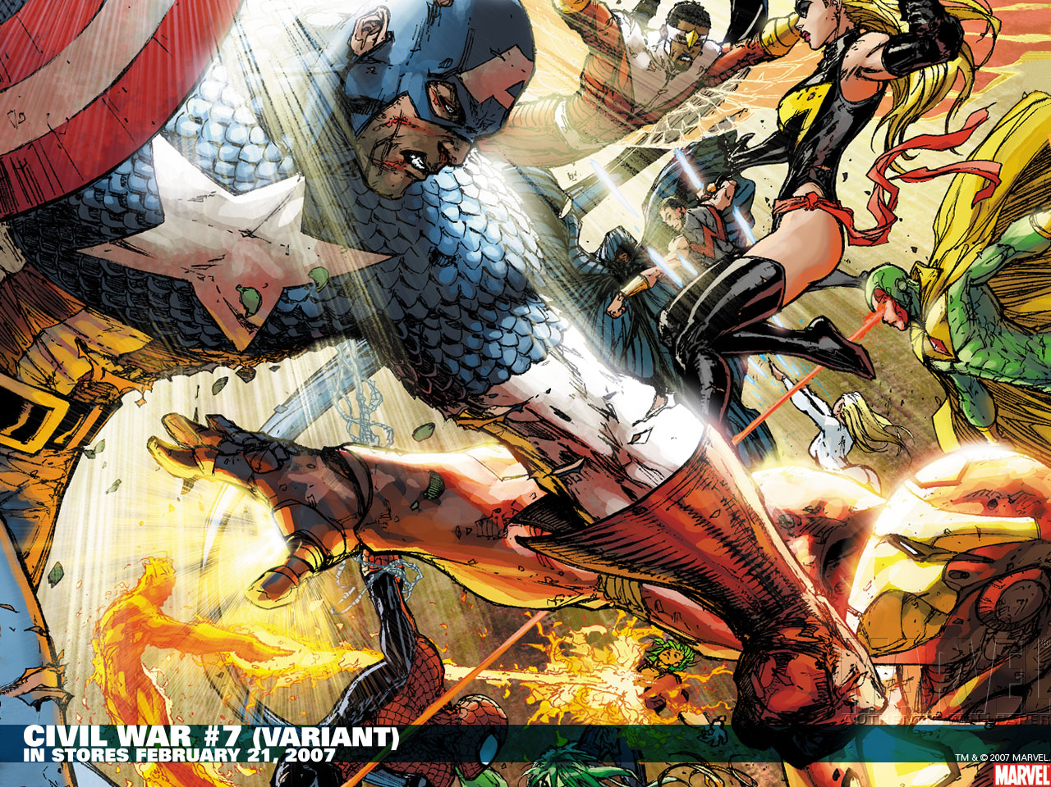

Slide 14
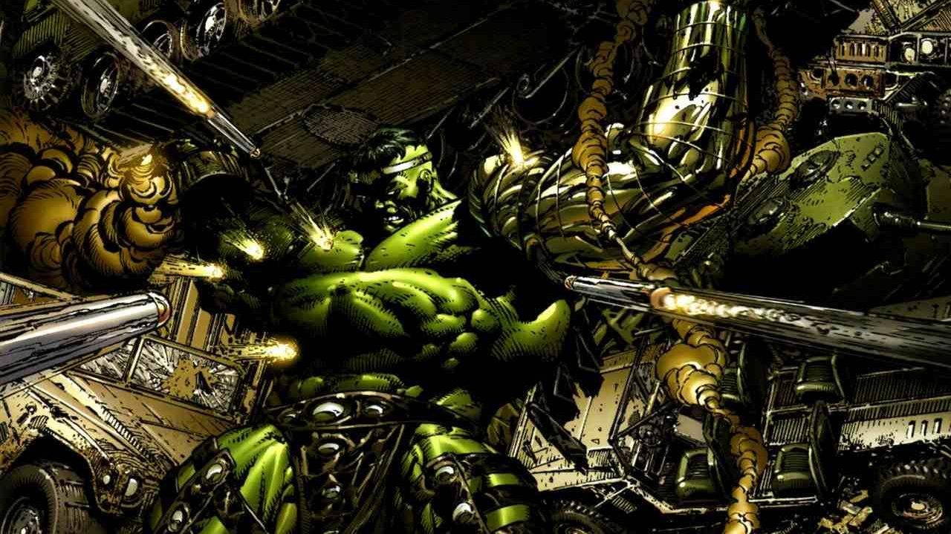
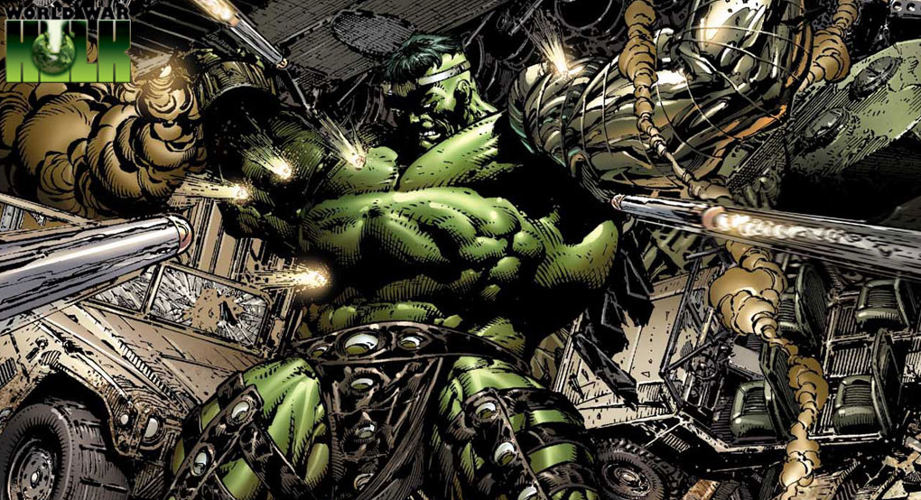
3
绿巨人：世界大战HULK: THE WORLD WAR

Slide 15
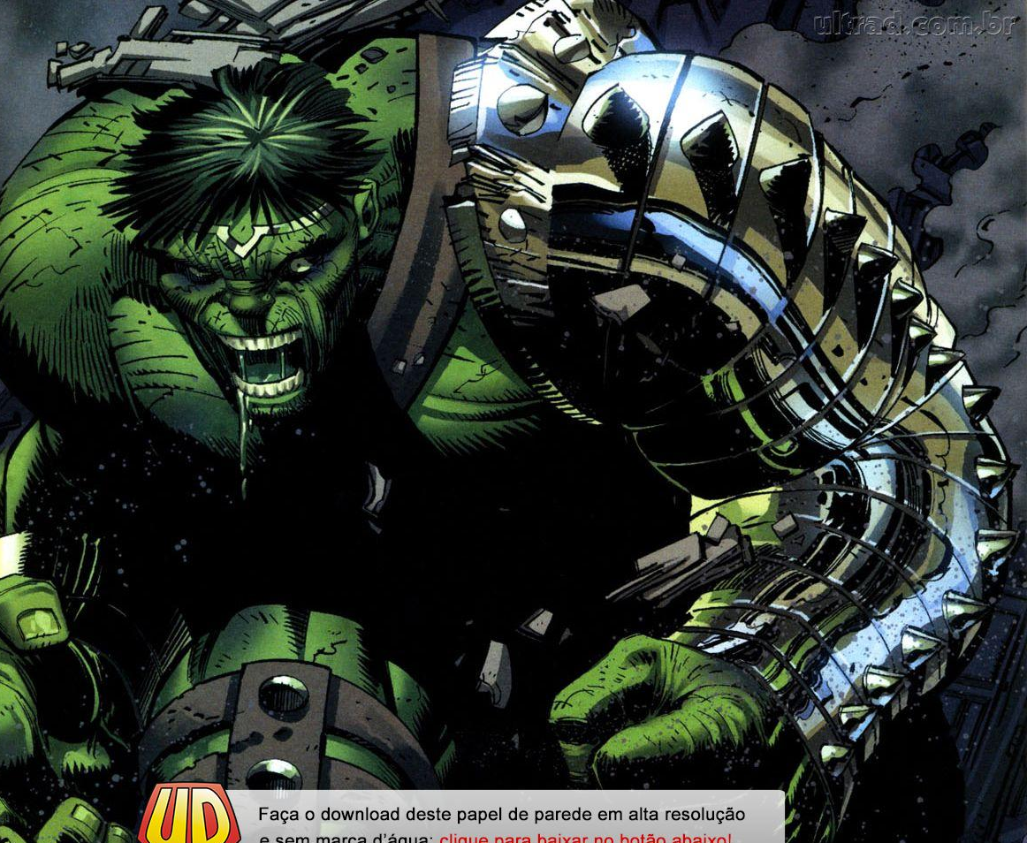
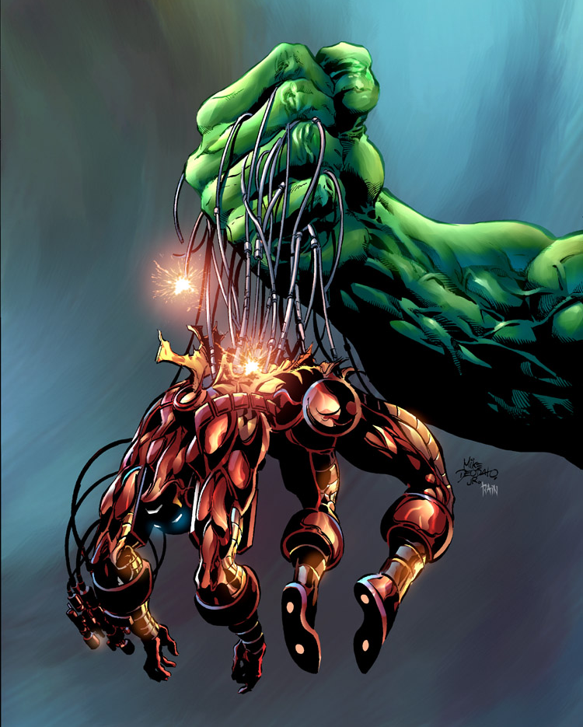

Slide 16
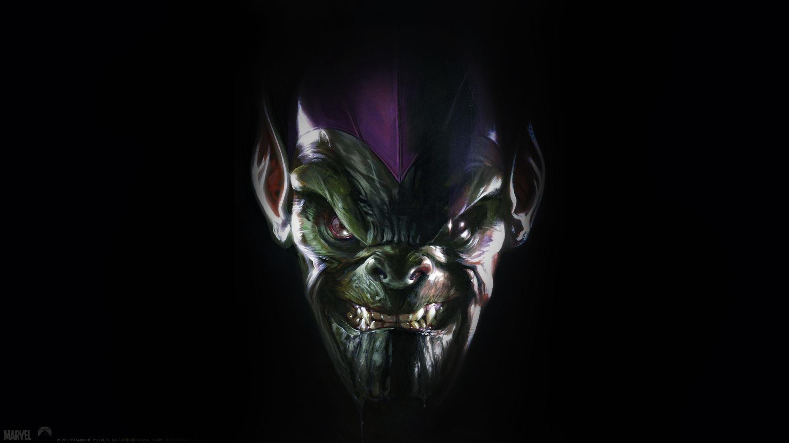
4
秘密入侵
SECRET INVASION

Slide 17
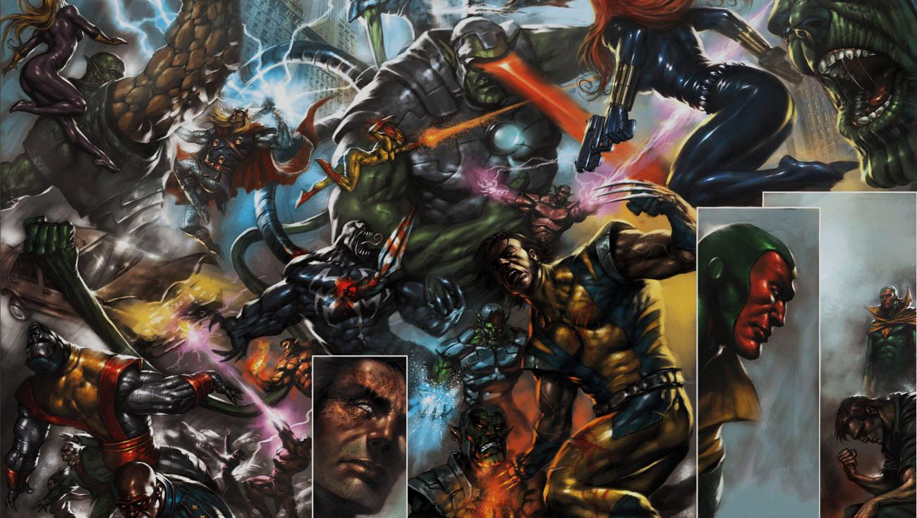

Slide 18
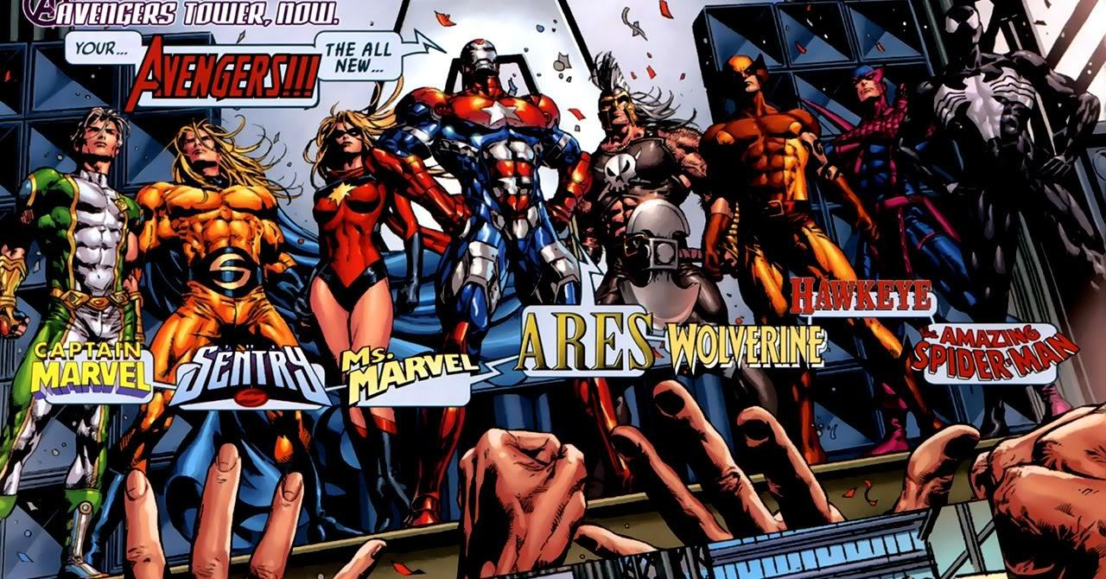
5
黑暗王朝
DARK REIGN

Slide 19

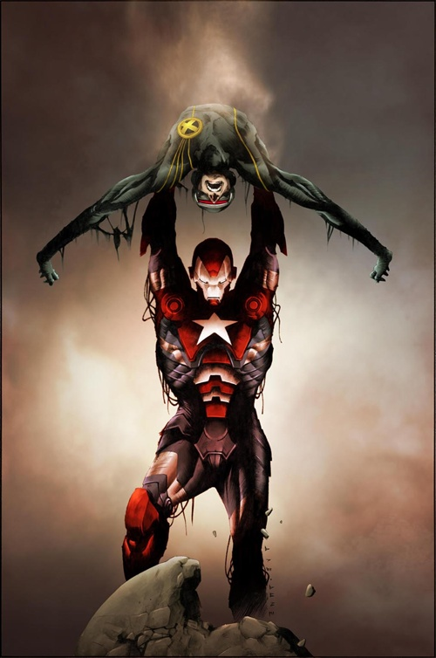

Slide 20
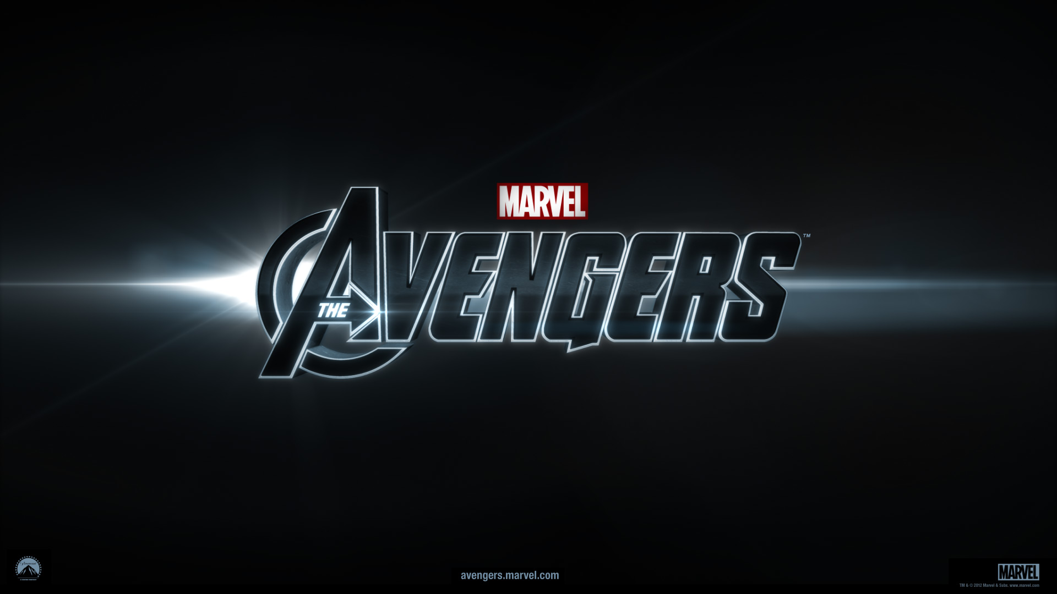

Slide 21
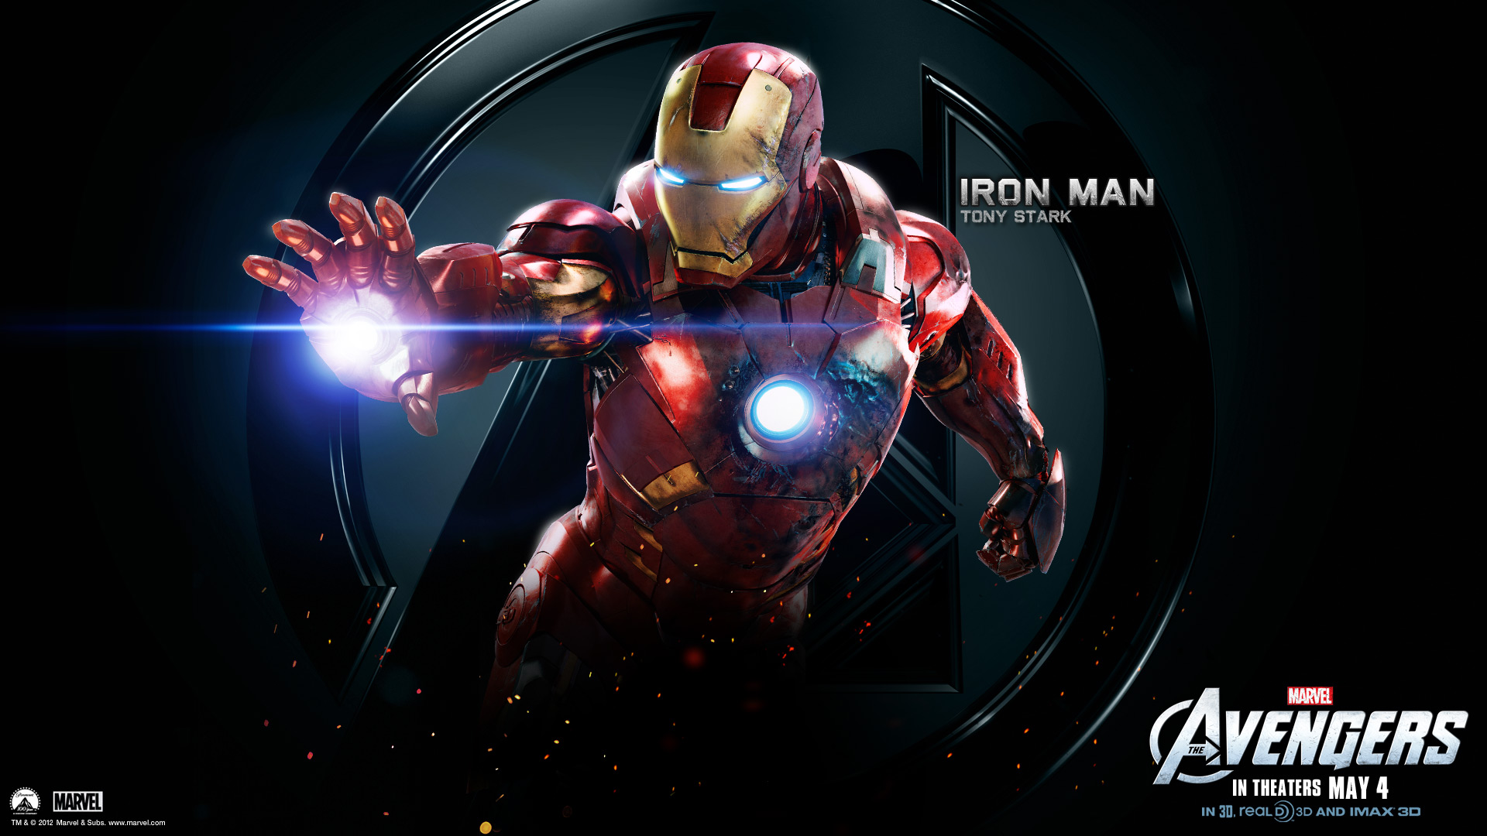

Slide 22
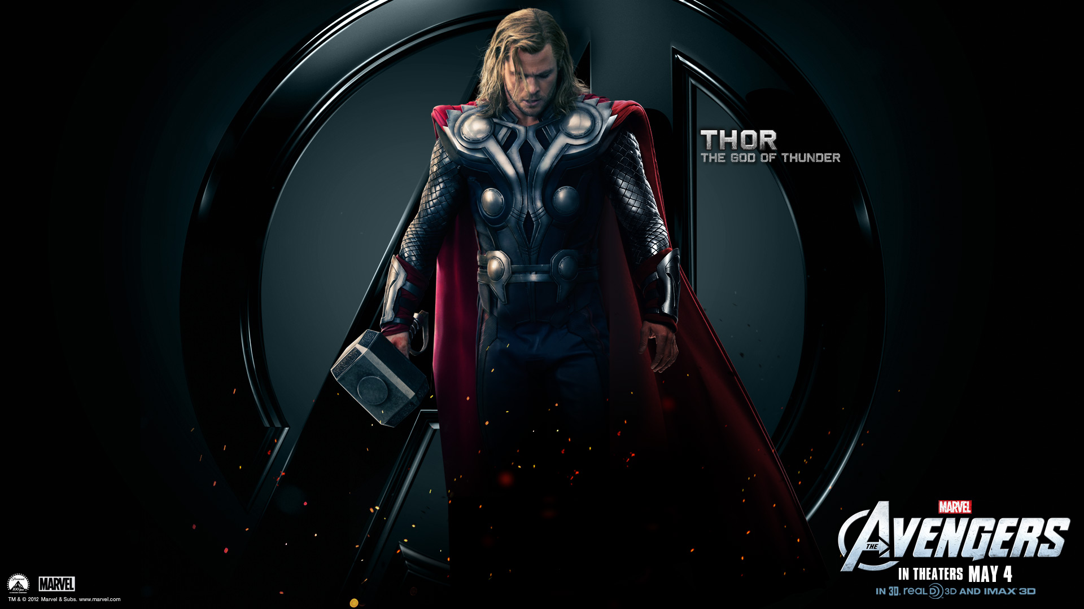

Slide 23
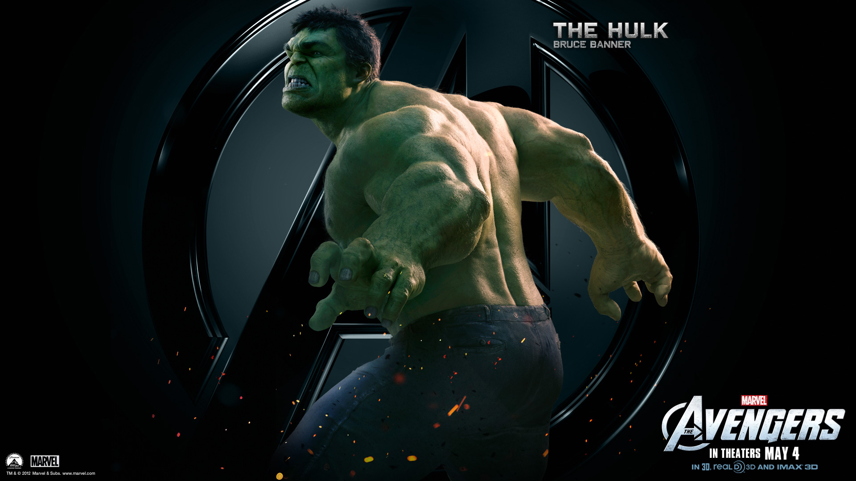

Slide 24
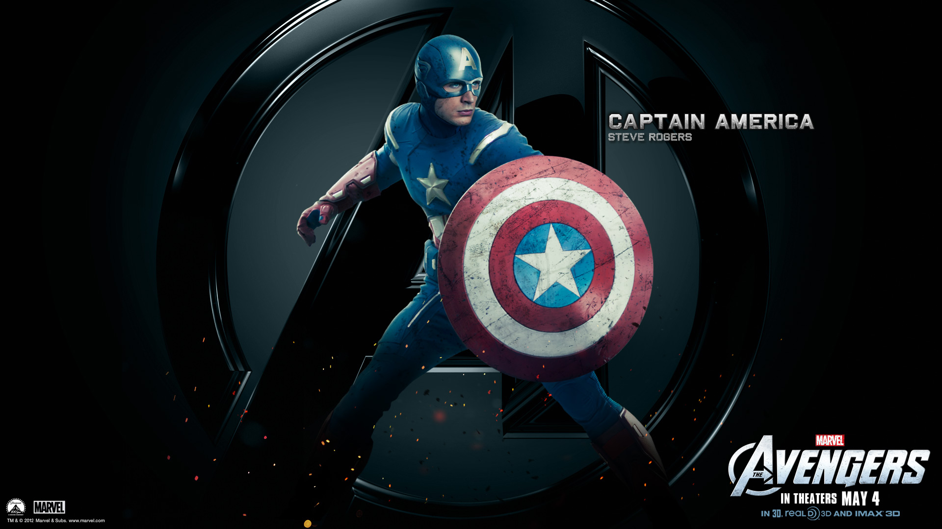

Slide 25
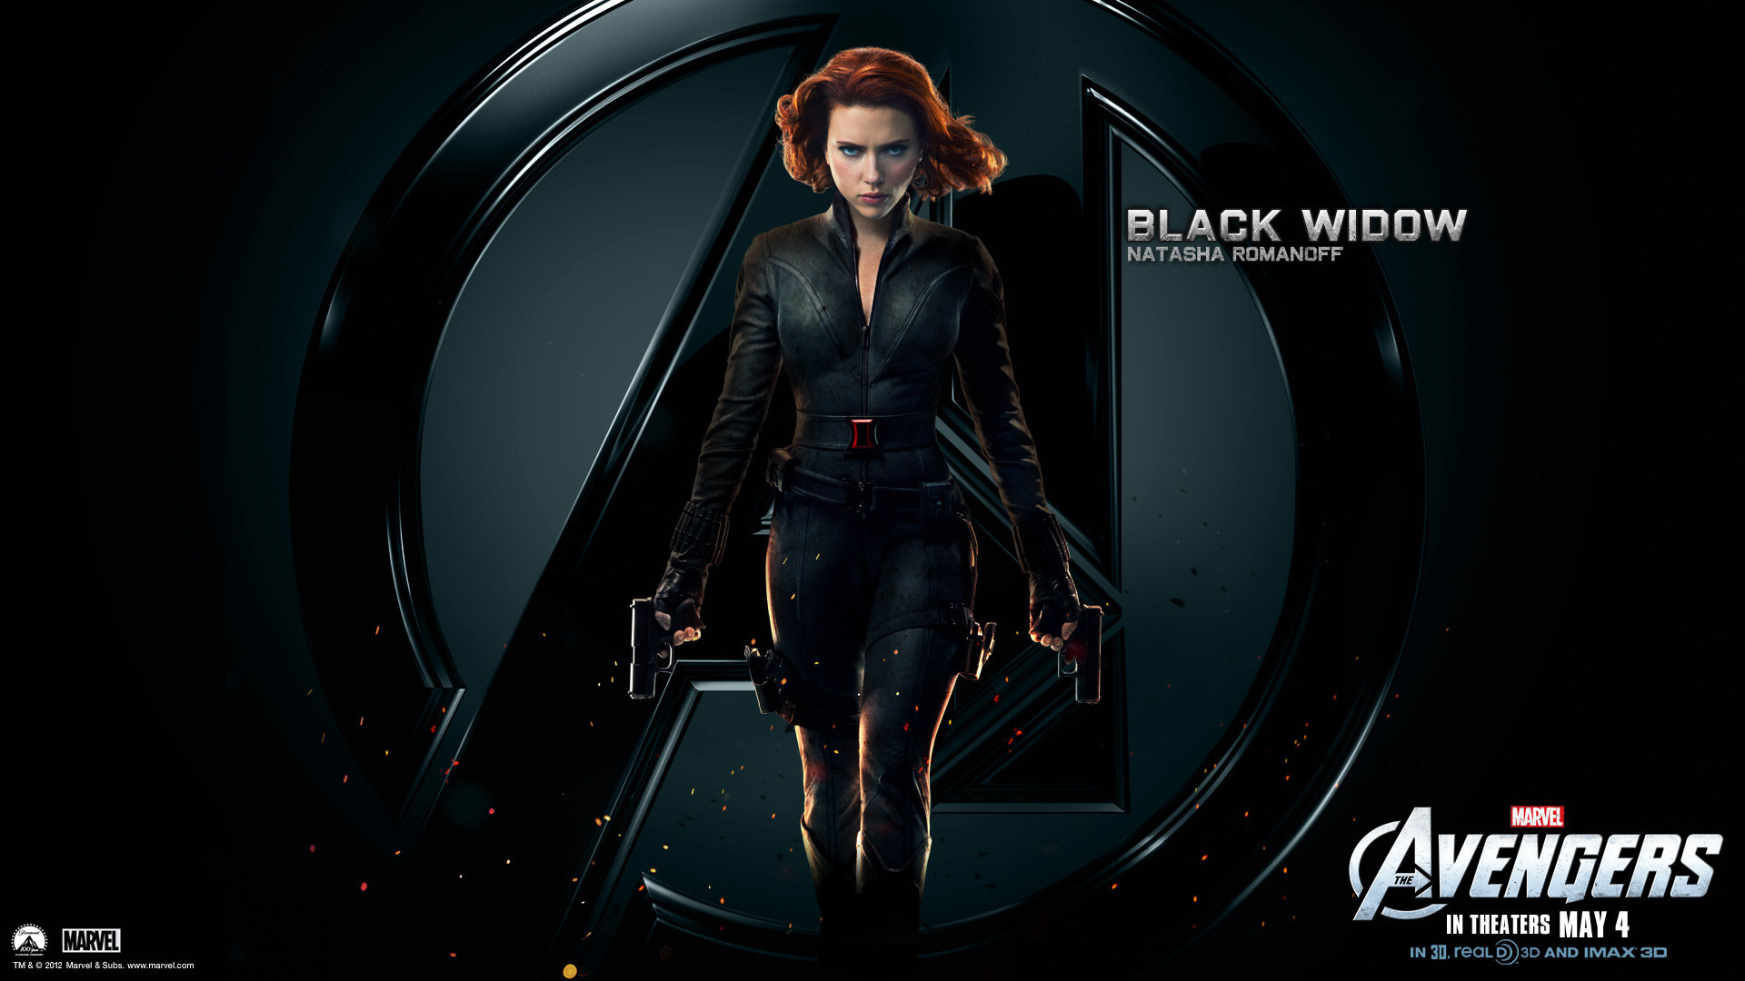

Slide 26
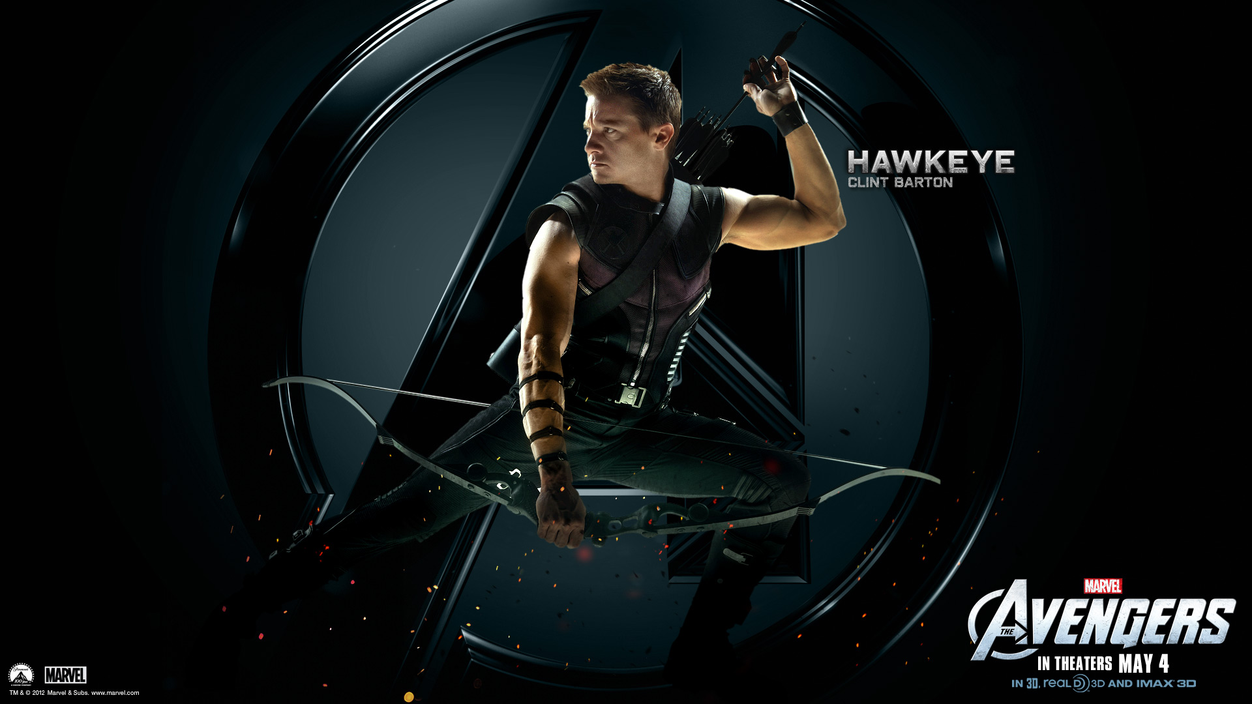

Slide 27


Slide 28
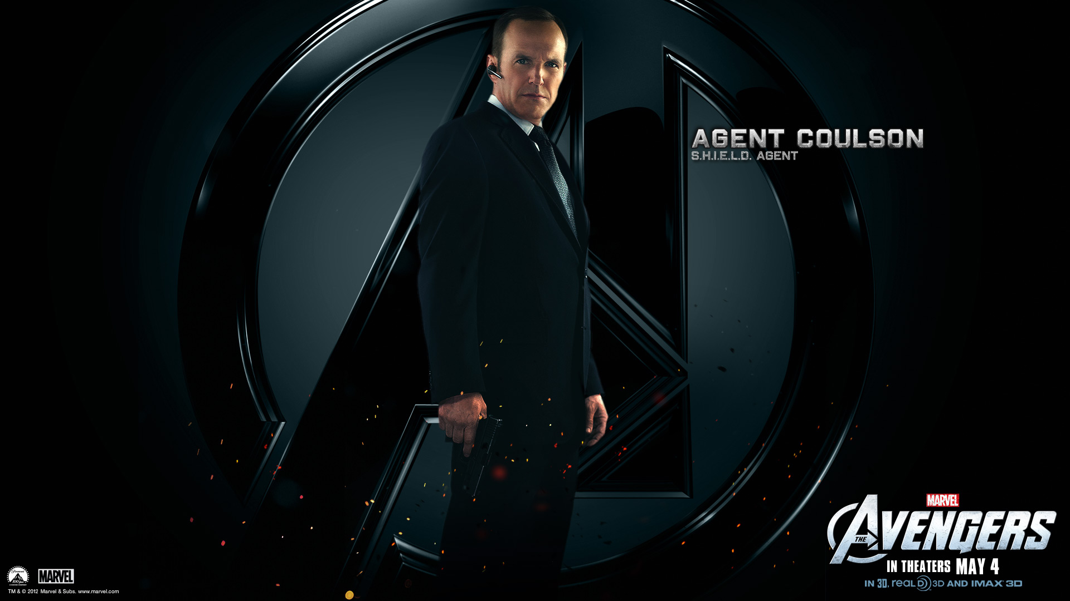

Slide 29
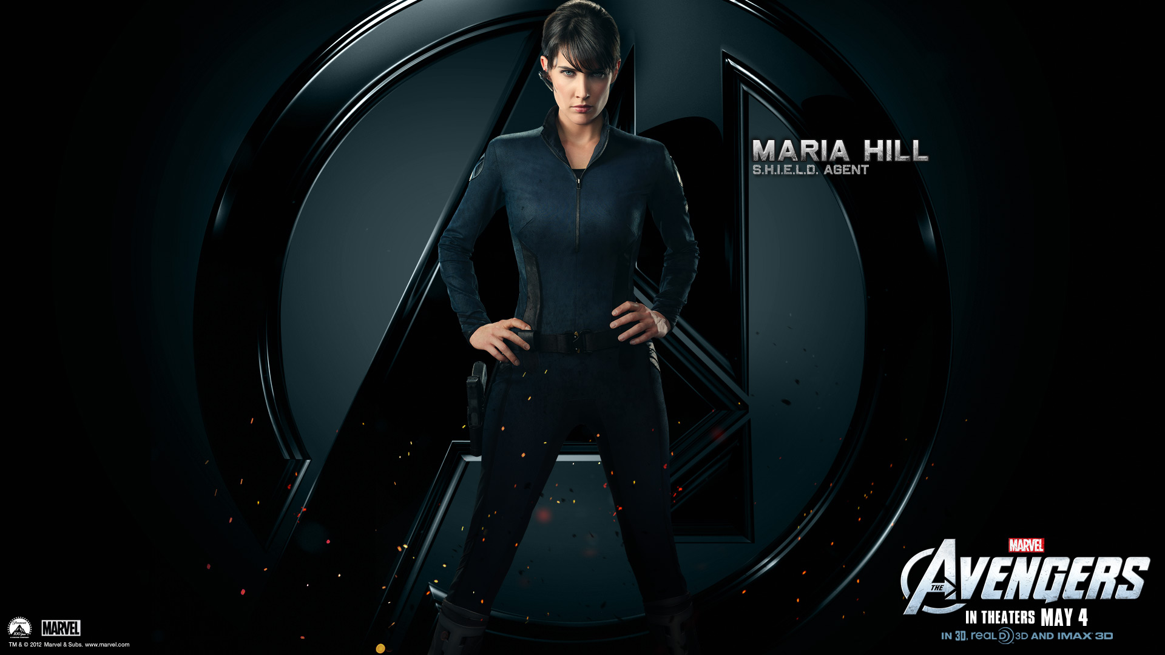

Slide 30
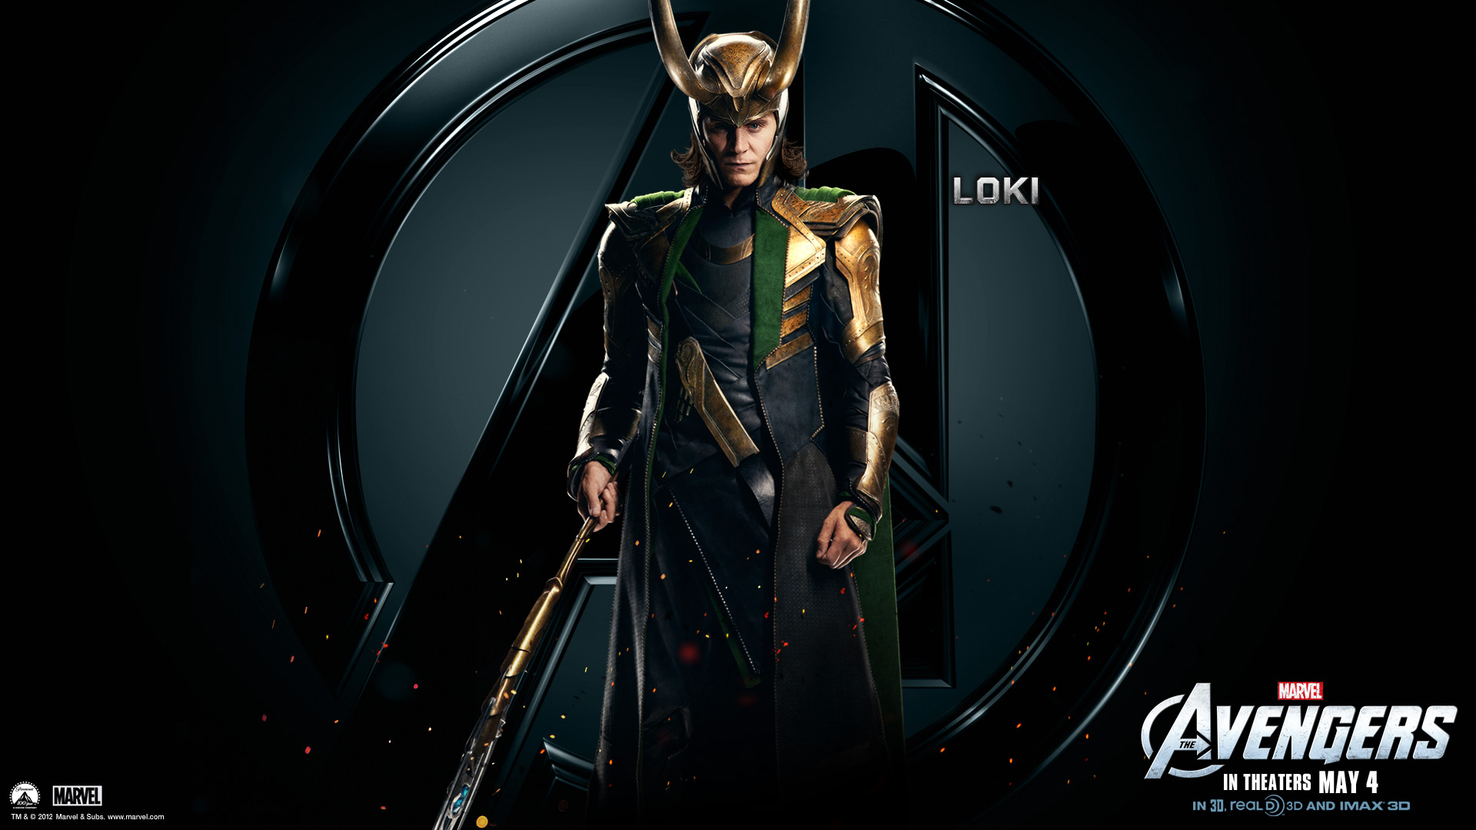

Slide 31
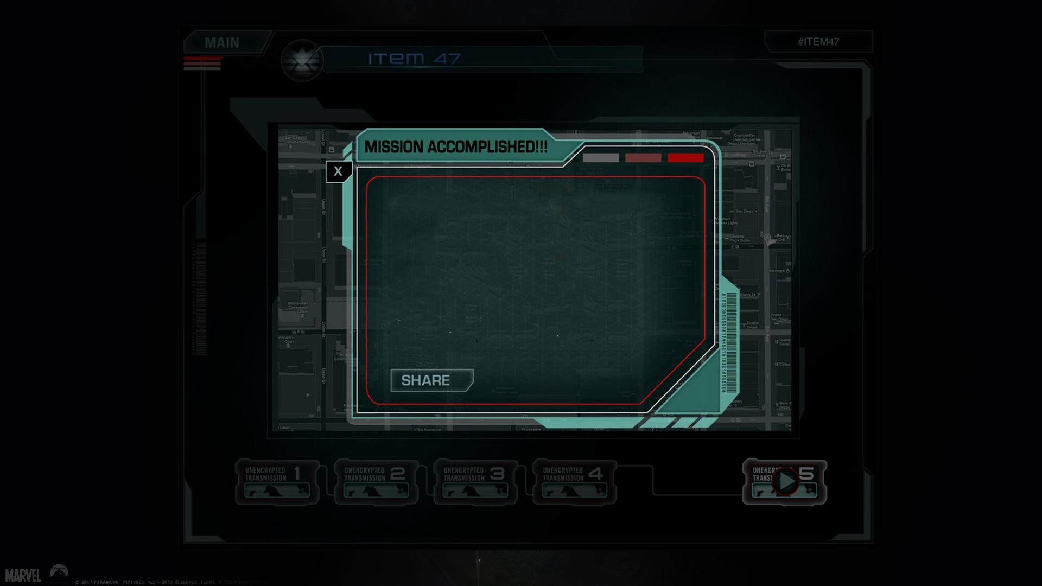
THANK YOU.
BY SIMON
www.51pptmoban.com 发布

